Slide 1
Audit

Slide 2
Architecture Importance Of Audit Table Structures Use Case Batch Key and its Usage
Agenda

Slide 3
Architecture
Data Lake / Staging
CDM
Reference
Audit
Dedicated Schema Per BI Tool
Master Data Without a Source
Managed of Load Processes
CUBE
TABLEAU
Source Staging
Database
DBO
DBO
MSTR
Warehouse
Mart
Source Staging
Database
Single Version of Operational Facts
Managed Versions of Analytics Structures
Source Data
Structures + Augmentation

Slide 4
Why Auditing?
We know that flexibility comes with the responsibility to use the tools properly; when poorly configured, data can simply disappear or end up transformed improperly.
ETL auditing is rarely the most visible element in the architecture, but it is a necessary insurance policy to protect the integrity of the data and the process.
In our case the Audit table are available in the schema called CDM(Centric Data Management) by default. Below are the salient feature of the EDW 2.0 auditing system.
Maintained in dedicated schema
Integrated into ETL Event Handlers
Captures each package execution
Manages incremental load values
Enables CDC capability through Batch Keys
Tags each record (Staging > EDW)

Slide 5
Audit Tables : Schema CDM
Process- It captures audit data at process (workflow) level e.g. what time a single package/pipeline was initiated , concluded and last batch information in which it was executed. This table helps in deciding the begin date timestamp for CDC data.
Process_batch- It captures audit data at batch level. Daily ETL load is called as a new batch with a unique identification number hence this table keeps historical detailed information about each process e.g. when package/pipeline was initiated, concluded, total source records fetched, inserted/updated/deleted/unprocessed records etc.
Process_batch_error- As part of audit framework, it was needed to capture the error logs as well and there comes process_batch_error table. Each error thrown by invoked process gets logged in this table.
NOTE:- Process table has process_uid (workflow name) and is linked with process_batch table with process_uid itself. Process_batch keeps a unique batch_id against each process and same is referenced in process_batch_error table.

Slide 6
Audit Database Objects : Schema CDM
[cdm].[process_batch_initiate_internal]- Given a Data Management Process UID this procedure initiates a new process batch, automatically applying the Internal Sequence Indicator = 1.
[cdm].[process_batch_initiate]- Given a Data Management Process UID this procedure initiates a new process batch.
[cdm].[process_register]-Creates Data Management Process UID if it does not already exist in the cdmROC table.
[cdm].[process_batch_key_provider]- Database sequence used to provide process_batch_key.
[cdm].[process_derive_sequence]- Given a Data Management Process UID this procedure determines the next Start and End Sequence Keys (or Datetimes) needed to bound incremental processing in the current execution of a cdmROC batch.
[cdm].[process_batch_error_log]- Logs an error associated with a Process Batch Key.
[cdm].[process_batch_conclude]- Given a Process Batch Key, conclude the batch indicating failure or success.
Note:- Above database objects/scripts are explained in their execution order.

Slide 7
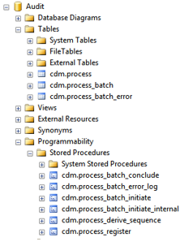
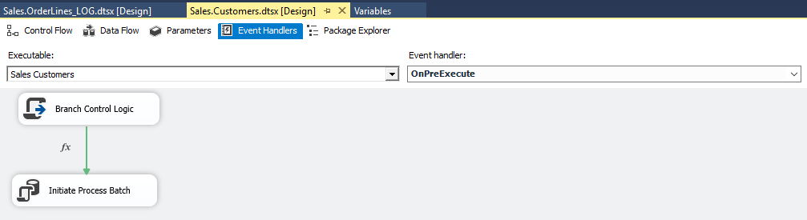
Below is the structure of the table structure in the CDM schema(Truncate Load)
It is implemented through Event Handlers in different packages in SSIS:
OnPreExecute.
OnPostExecute
OnError
OnPreExecute: This call a procedure process_batch_initiate_internal which takes on the below parameters from the Job:

Slide 8
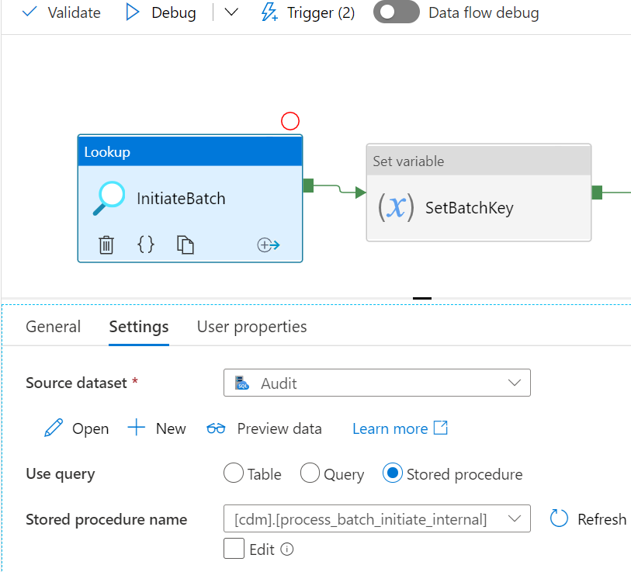
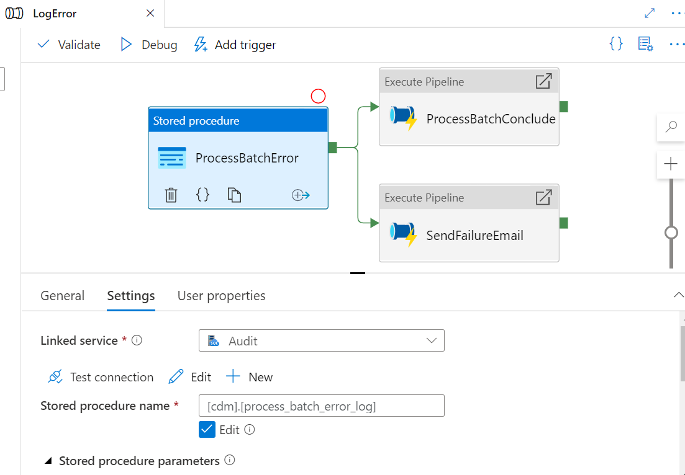
Audit Process - ADF
Audit process works in similar way whether it is SSIS/ADF. Added the snapshots for reference how the same is being called in ADF. Below are the pre/post events that are responsible in logging audit data in audit tables.
InitiateBatch- 2. LogError

Slide 9
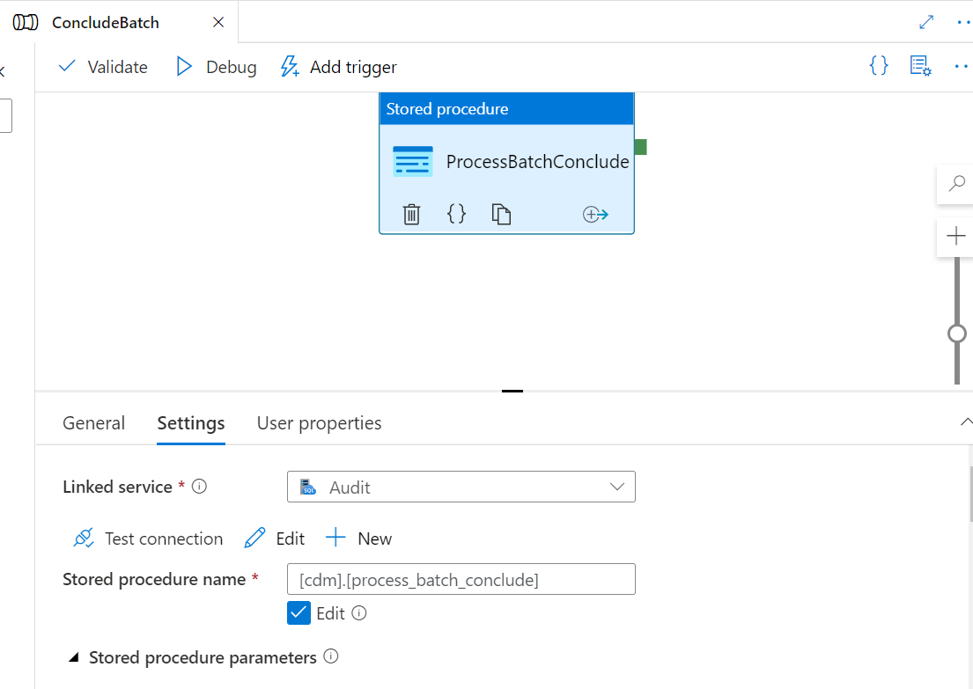
3. ConcludeBatch:-

Slide 10
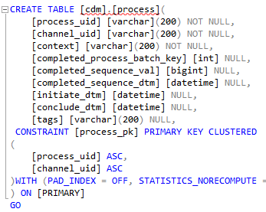
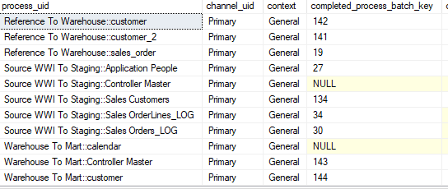
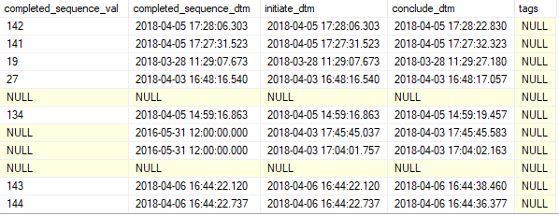
Below is the schema and the sample data for cdm.process table.

Slide 11
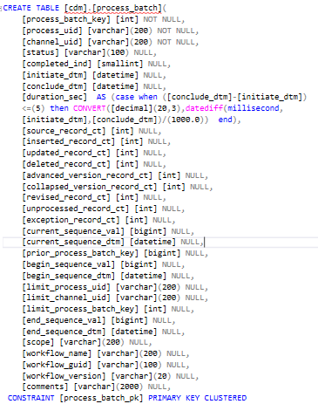
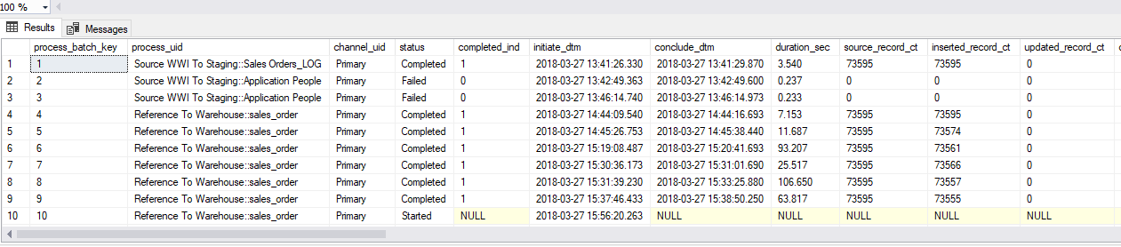
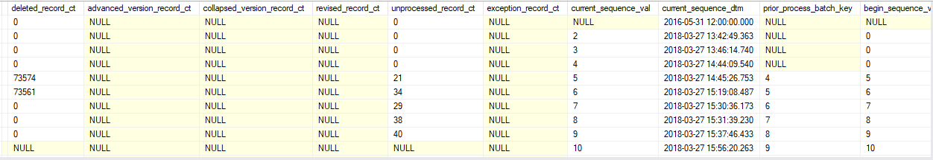
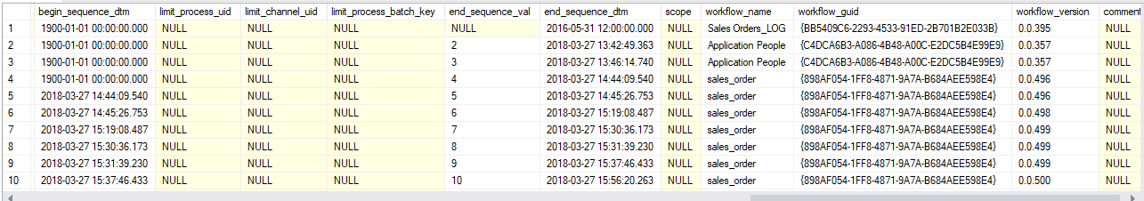
The structure and data snippet of the core Audit table: Process Batch

Slide 12
The important code snippets that guides the pre-execute audit process
IF @internal_sequence_ind = 1 BEGIN
SET @current_sequence_val = @process_batch_key;
SET @current_sequence_dtm = @initiate_dtm;
END;
SELECT
@prior_process_batch_key = p.completed_process_batch_key
, @begin_sequence_val = p.completed_sequence_val
, @begin_sequence_dtm = p.completed_sequence_dtm
FROM
cdm.process p
WHERE
p.process_uid = @process_uid
AND p.channel_uid = @channel_uid;
IF @end_sequence_val IS NULL OR @end_sequence_val > @current_sequence_val
BEGIN
SET @end_sequence_val = @current_sequence_val;
END;
IF @end_sequence_dtm IS NULL OR @end_sequence_dtm > @current_sequence_dtm
BEGIN
SET @end_sequence_dtm = @current_sequence_dtm;
END;
END;

Slide 13
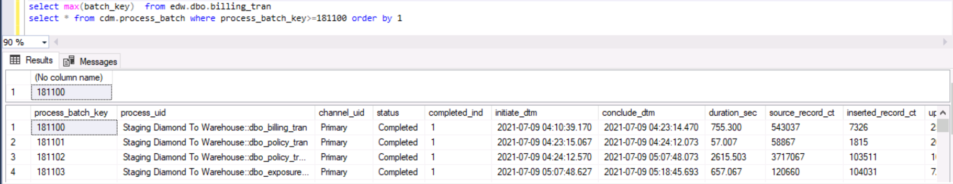
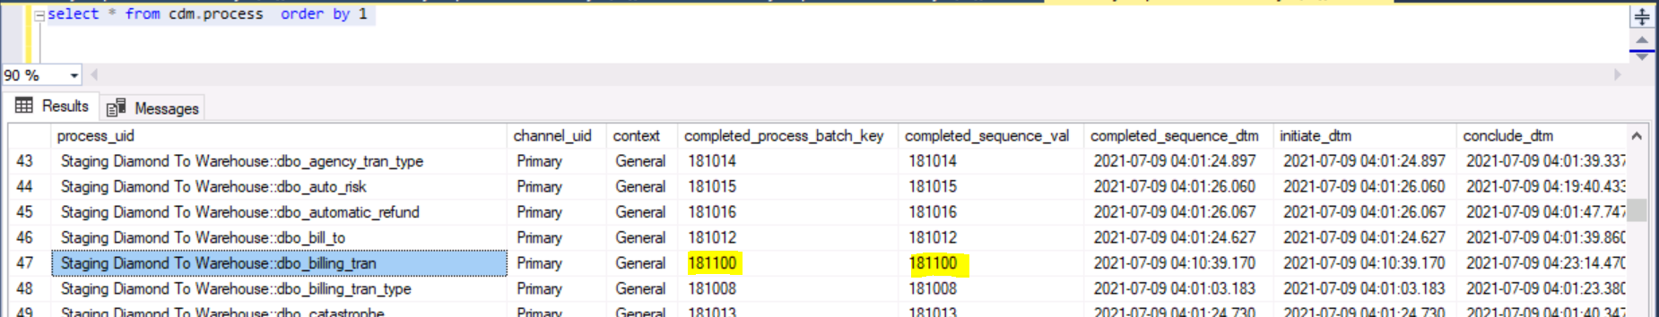
Batch Key :-
1->Process batch key in [cdm].[process batch] is used as a batch key in respective target table.
​2-> During pre-execution event, a new sequence value is generated from [cdm].[process_batch] and same is populated as batch key in target table and [cdm].[process] table is also gets updated with new generated batch key for respective package.

Slide 14
Good things
- Auditing
- Error Log
- Delta are handled as updates
- Scalability of development and framework to be automated

